Slide 1

Archiving Emails
JOB AID
Version: 1
Disclaimer: Copyright © 11/11/2021 Ocwen Financial Corporation, Inc. all rights reserved. This document contains
valuable confidential and proprietary information and/or trade secrets of Ocwen Financial Corporation, Inc. This
material may not be disclosed, reproduced, or distributed, in whole or in part, without the prior written approval of
Ocwen Financial Corporation, Inc. Ocwen Financial Corporation and the Ocwen Financial Corporation logo are
trademarks or registered trademarks of Ocwen Financial Corporation, Inc., West Palm Beach, Florida, USA.

Slide 2


Are you holding on to emails from five years ago because you are afraid to delete them? Be not afraid!
Archive Mailbox
Everyone has an Online Archive folder in their MS Outlook. You can manually move emails or they will automatically move after two years.
The Online Archive folder is a specialized mailbox that appears alongside the user’s primary mailbox folders in Outlook or Outlook Web Access. You can access the archive in the same way that you access the primary mailbox.
Reasons for Using the Online Archive
1
Even if your primary mailbox has 100 gigabytes of storage capacity, it’s still helpful to use the Online Archive when you need to free up some storage capacity.
It preserves and protects all inbound and outbound email messages (as well as attachments and metadata) so they can be accessed at a later date.
2
1

Slide 3
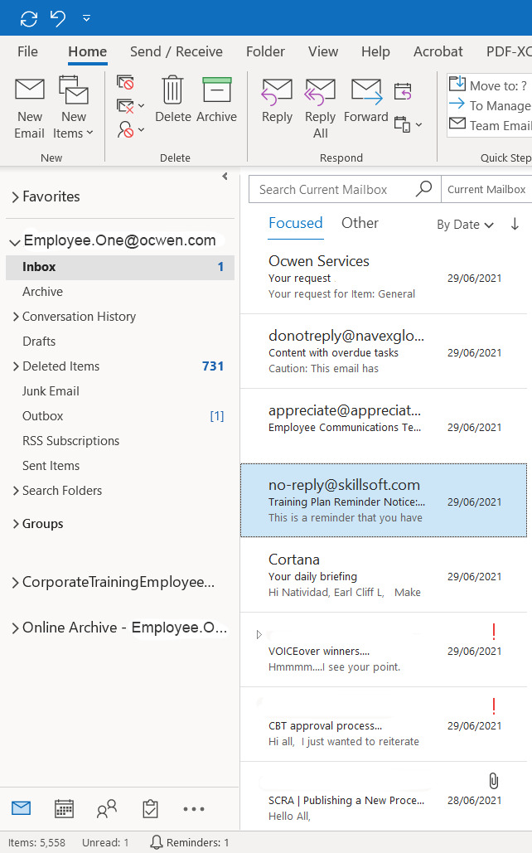
Features of the Archive Mailbox
1
Unlimited archive email storage that
does not use your primary mailbox quota
Messages can be moved to the archive manually or they will move automatically when they are older than two years
The Online Archive is easily accessible through MS Outlook and OWA (In OWA, the folder is called In-Place Archive)
When using Outlook 2013 and higher, archived messages are searchable and viewable using MS Outlook and OWA
2
3
4
How to archive emails in Microsoft Outlook
1
The archive mailbox will show up in this format by default in Outlook.
2
To use the feature manually, you may drag and drop your emails from your Inbox to Online Archive.
2

Slide 4
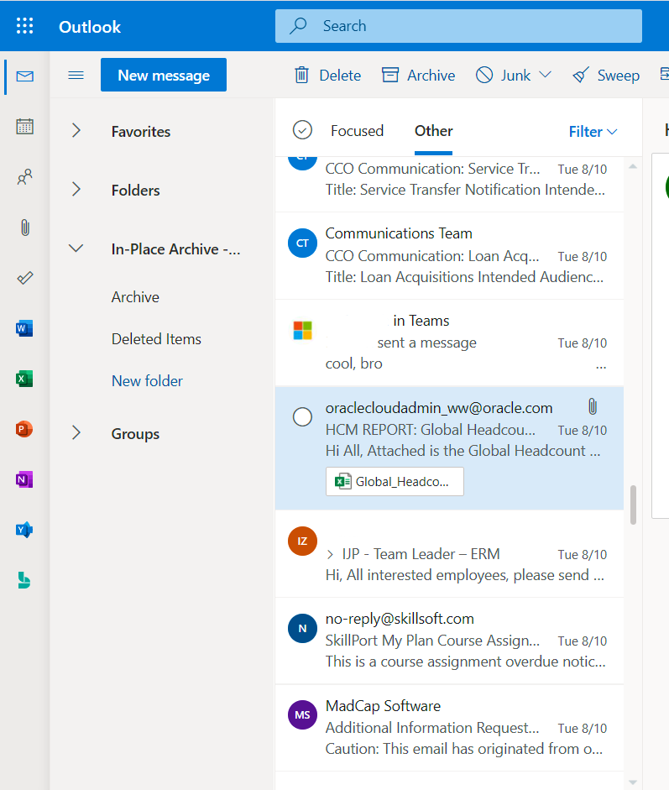
How to archive emails in Outlook Web Access
1
The archive mailbox will show up in this format by default in Outlook.
2
To use the feature manually, you may drag and drop your emails from your Inbox to Online Archive.
3

